Slide 1
Building the Cloud Native Kernel
Kubernetes Release Engineering
Stephen Augustus
SIG Release Co-Chair
Lead, Cloud Native Advocacy & Tooling
saugustus@vmware.com
Tim Pepper
SIG Release Co-Chair
Snr. Staff Engr, Open Source Technology Center
tpepper@vmware.com
Notes:
Original content licensed CC BY 4.0 for remix/reuse.

Slide 2

Time Machine: December 7, 2017
Notes:
Photo by Oliver Hale on Unsplash

Slide 3
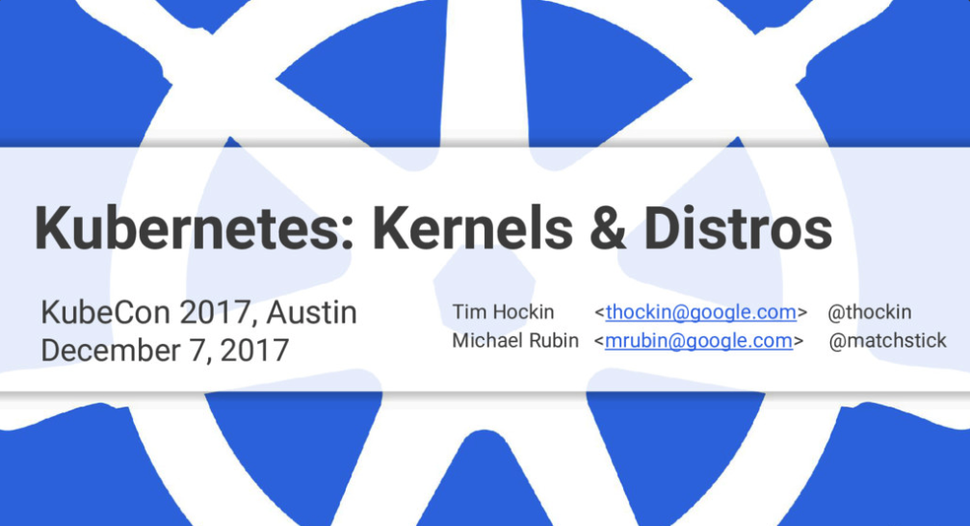
Notes:
https://speakerdeck.com/thockin/kubecon-2017-kernels-and-distros
This was the KubeCon where Contributor Summit featured the
https://github.com/kubernetes/community/blob/master/events/2017/12-contributor-summit/breaking-up-the-monolith.md
“Breaking up the Monolith” session.
Tim/Michael talk went into more detail about the Linux distro vs kernel split, the benefits of this world view, how it could be applicable to Kubernetes, risks and benefits of changing and not changing how Kubernetes is developed and DELIVERED.

Slide 4

Kubernetes is the Linux of the Cloud
Notes:
So easy to say.
But what does it mean?
“Cloud” is fuzzy enough already on its own.
Photo by Alex Machado on Unsplash

Slide 5

Kubernetes is the Linux of the Cloud
Notes:
And what is Kubernetes really?
Photo by Alex Machado on Unsplash
K8s logo: https://github.com/kubernetes/kubernetes/tree/master/logo

Slide 6

Kubernetes is the Linux of the Cloud
Notes:
And what is Linux really?
But what does it really mean??
Photo by Alex Machado on Unsplash
K8s logo: https://github.com/kubernetes/kubernetes/tree/master/logo
The Kubernetes logo files are licensed under a choice of either Apache-2.0 or CC-BY-4.0 (Creative Commons Attribution 4.0 International).
Tux: https://www.kernel.org/theme/images/logos/tux.png
This file is made available under the Creative Commons CC0 1.0 Universal Public Domain Dedication.
The person who associated a work with this deed has dedicated the work to the public domain by waiving all of their rights to the work worldwide under copyright law, including all related and neighboring rights, to the extent allowed by law. You can copy, modify, distribute and perform the work, even for commercial purposes, all without asking permission.

Slide 7
What is Kubernetes
Kubernetes
large, open developer community
monolithic core
core is a commodity
millions of lines of code
core requires other independent out-of-core components
opinionated distributions

Slide 8
What is Linux
Linux
large, open developer community
monolithic core
core is a commodity
millions of lines of code
core requires other independent out-of-core components
opinionated distributions

Slide 9
Kubernetes
Linux
large, open developer community
monolithic core
core is a commodity
millions of lines of code
core requires other independent out-of-core components
opinionated distributions
large, open developer community
monolithic core
core is a commodity
millions of lines of code
core requires other independent out-of-core components
opinionated distributions
Notes:
Interesting….
Is it too early on the first day of the conference for this level of mind blowing comparison…?
Brace yourselves...

Slide 10
Linux
Kubernetes
large, open developer community
monolithic core
core is a commodity
millions of lines of code
core requires other independent out-of-core components
opinionated distributions
large, open developer community
monolithic core
core is a commodity
millions of lines of code
core requires other independent out-of-core components
opinionated distributions
Notes:
Maybe Kubernetes is the Linux of the cloud???

Slide 11
Kubernetes is the Linux of the Cloud
Kubernetes
Linux
large, open developer community
monolithic core
core is a commodity
millions of lines of code
core requires other independent out-of-core components
opinionated distributions
large, open developer community
monolithic core
core is a commodity
millions of lines of code
core requires other independent out-of-core components
opinionated distributions
Notes:
But, I’ve cheated.
I’ve been a little cloudy on what is Linux.

Slide 12
Kubernetes is the Linux of the Cloud
Kubernetes
Linux
large, open developer community
monolithic core
core is a commodity
millions of lines of code
core requires other independent out-of-core components
opinionated distributions
large, open developer community
monolithic
core is a commodity
millions of lines of code
core requires other independent out-of-core components
opinionated
kernel
distributions
Notes:
There’s the linux kernel and there are linux distributions

Slide 13
Kubernetes
Linux
GitHub.com/kubernetes/kubernetes
Kernel.org
Notes:
A “distribution” is more than just the core. Yes there is a core.

Slide 14
Kubernetes
Linux
GitHub.com/kubernetes/kubernetes
Rapid core release (4 per year)
Kernel.org
Rapid core release (6 per year)
Notes:
And the core has its release cadence.
(faster generally thought to be better)

Slide 15
Kubernetes
Linux
GitHub.com/kubernetes/kubernetes
Rapid core release (4 per year)
Independent out-of-core releases
Kernel.org
Rapid core release (6 per year)
Independent out-of-core releases
Notes:
A “distribution” is more than just the core.
But also ALL THE THINGS you need to run something useful.
Those things all run on their own cadence. Some are simple, established, more “done”. Less frequent releases can be a benefit.
But then there’s also security bug fixes in all of these. Combinatorial explosion of version possibilities.

Slide 16
Kubernetes
Linux
GitHub.com/kubernetes/kubernetes
Rapid core release (4 per year)
Independent out-of-core releases
Golang standard library (and others)
Kernel.org
Rapid core release (6 per year)
Independent out-of-core releases
libc (and others)
Notes:
Usually a tightly coupled “standard” library aspect.

Slide 17
Kubernetes
Linux
GitHub.com/kubernetes/kubernetes
Rapid core release (4 per year)
Independent out-of-core releases
Golang standard library (and others)
Networking (CNI)
Kernel.org
Rapid core release (6 per year)
Independent out-of-core releases
libc (and others)
Networking
Notes:
Communications

Slide 18
Kubernetes
Linux
GitHub.com/kubernetes/kubernetes
Rapid core release (4 per year)
Independent out-of-core releases
Golang standard library (and others)
Networking (CNI)
Storage (CSI)
Kernel.org
Rapid core release (6 per year)
Independent out-of-core releases
libc (and others)
Networking
Storage
Notes:
Persistent data

Slide 19
Kubernetes
Linux
GitHub.com/kubernetes/kubernetes
Rapid core release (4 per year)
Independent out-of-core releases
Golang standard library (and others)
Networking (CNI)
Storage (CSI)
Runtime (CRI)
Kernel.org
Rapid core release (6 per year)
Independent out-of-core releases
libc (and others)
Networking
Storage
Loaders, linkers, interpreters
Notes:
Ability to actually run users’ stuff

Slide 20
Kubernetes
Linux
GitHub.com/kubernetes/kubernetes
Rapid core release (4 per year)
Independent out-of-core releases
Golang standard library (and others)
Networking (CNI)
Storage (CSI)
Runtime (CRI)
Cloud providers
Kernel.org
Rapid core release (6 per year)
Independent out-of-core releases
libc (and others)
Networking
Storage
Loaders, linkers, interpreters
Multiple hardware architectures
Notes:
Some where to run the stuff...platform support

Slide 21
Kubernetes
Linux
GitHub.com/kubernetes/kubernetes
Rapid core release (4 per year)
Independent out-of-core releases
Golang standard library (and others)
Networking (CNI)
Storage (CSI)
Runtime (CRI)
Cloud providers
Developer tools, app frameworks
Kernel.org
Rapid core release (6 per year)
Independent out-of-core releases
libc (and others)
Networking
Storage
Loaders, linkers, interpreters
Multiple hardware architectures
Developer tools, app frameworks
Notes:
Enable dev’s to build interesting things

Slide 22
Kubernetes
Linux
GitHub.com/kubernetes/kubernetes
Rapid core release (4 per year)
Independent out-of-core releases
Golang standard library (and others)
Networking (CNI)
Storage (CSI)
Runtime (CRI)
Cloud providers
Developer tools
Cluster installers, config managers, logging, monitoring
Kernel.org
Rapid core release (6 per year)
Independent out-of-core releases
libc (and others)
Networking
Storage
Loaders, linkers, interpreters
Multiple hardware architectures
Developer tools
System installers, config managers, logging, monitoring
Notes:
Enable administrators to manage the system
So a “distribution” is more than just the core. It is all the things you need to run something useful.

Slide 23

Notes:
There’s a lot of moving parts in a distribution.
Photo by Florian Klauer on Unsplash

Slide 24

Distributions Offer Value
purpose built, opinionated
one release spans all components
coherent, self-consistent assembly
easier install, lifecycle management
testing & support
Notes:
That’s a lot of value. Seriously.
You don’t want to have to do that yourself. You’re not going to do it as well as a dedicated team of experienced professionals.
Distributions are one of the aggregator effects that make open source communities so compelling.
Photo by Florian Klauer on Unsplash

Slide 25








Many Distributions
Kubernetes
Linux
Notes:
Lots and lots of distributors are adding their unique value in a diverse marketplace. Hundreds of distributions!
Many companies making Linux distributions are now also making Kubernetes distributions.

Slide 26
Is Kubernetes really a distribution?
Distro benefits:
2017 talk described Kubernetes as:
Purpose built, opinionated
One release spans all components
Coherent, self-consistent assembly
Easier install, lifecycle management
Testing & support
Coupled core / non-core components
Complicated platform enablement
Incoherent, self-inconsistent assembly
Difficult installation, lifecycle management
Rough edges on testing & support

Slide 27
Is Kubernetes really a distribution?
Distro benefits:
2019 Kubernetes:
Purpose built, opinionated
One release spans all components
Coherent, self-consistent assembly
Easier install, lifecycle management
Testing & support
over 100
certified conformant
Kubernetes
vendors, hosted offerings, distributions

Slide 28
Certified conformant?
Kubernetes
Linux
Permissive licenses
Risk of divergent forking
Reciprocal licenses
Forks are public, reusable

Slide 29
Certified conformant?
Kubernetes
Linux
Permissive licenses
Risk of divergent forking
NEEDS a conformance test
Reciprocal licenses
Forks are public, reusable
Has no conformance test
Notes:
https://www.cncf.io/certification/software-conformance/

Slide 30

Certified conformant?
Kubernetes
Certified Vendors 101
Certified Products 127
Certified Distributions 63
Certified Hosted 41
Certified Installer 23
Permissive licenses
Risk of divergent forking
HAS a conformance test
Notes:
Awesome...are we done and good on the distro front?

Slide 31

Back to 2017 again...
3 possible community futures
others will make distros
one distro to rule them all
find a middle ground
Notes:
Photo by Caleb Jones on Unsplash

Slide 32
Back to 2017 again...
others will make distros: risks fragmentation, politicization
Notes:
Conformance helps with this! Hurray!
Photo by Caleb Jones on Unsplash

Slide 33
Back to 2017 again...
others will make distros: risks fragmentation, politicization
one distro to rule them all: practically impossible, fools' errand
Notes:
They said it couldn’t work. Nobody disagreed. We didn’t go there. Hurray!
Photo by Caleb Jones on Unsplash

Slide 34
Back to 2017 again...
others will make distros: risks fragmentation, politicization
one distro to rule them all: practically impossible, fools' errand
find a middle ground
Notes:
Have we found the middle ground?
Photo by Caleb Jones on Unsplash

Slide 35
Back to 2017 again...
others will make distros: risks fragmentation, politicization
one distro to rule them all: practically impossible, fools' errand
find a middle ground:
clean core, standards, processes
others will still do their own ("hopefully based on ours")
derived distros benefit from staying close
Notes:
Have we found the middle ground?

Slide 36
Find a Middle Ground
Multiple discussion points in 2017
cluster install / mgmt commonizing
splitting out cloud providers
adapting the release cadence & support lifetime
community, different skills, different focus
Led to subsequent activity!
Notes:
Talk had shared a variety of concrete ideas to brainstorm, many of which have happened or are happening or are in discussion

Slide 37
Find a Middle Ground
others will still do their own ("hopefully based on ours")
derived distros benefit from staying close
community, different skills, different focus

Slide 38
Find a Middle Ground
others will still do their own ("hopefully based on ours")
derived distros benefit from staying close
community, distro skills, distro focus
Notes:
Have we been thinking like a distro? What would that mean?

Slide 39
Many Distributions
Kubernetes
Linux
Notes:
I left something off this slide earlier

Slide 40


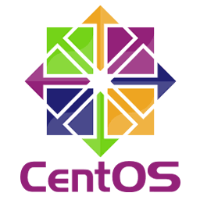

Many Distributions
Kubernetes
Linux
Notes:
“Community Distributions” distinct from “Commercial Distributions”
...Where are the Kubernetes community distributions?
Most of the 100 conformant offerings are small, not the big few names I deceptively highlighted. But most are commercial. There are a few non-commercial ones out there.
They actually do exist, but they don't have the name recognition of Arch/Centos/Debian/Fedora/OpenSuSE or the same size community of distro maintainers doing all the opinionated distro things.

Slide 41

The Community Distro
others will still do their own
hopefully based on ours
derived distros benefit from staying close
Notes:
Photo by Nathan Waters on Unsplash

Slide 42
The Community Distro
Implied:
A thing to stay close to
A thing to base on
A reference implementation
Notes:
Photo by Nathan Waters on Unsplash
For lack of a better phrase...where's the "Debian of Kubernetes?"

Slide 43
The Community Distro
Could it be our:
raw golang binaries (dl.k8s.io)?
containers (k8s.gcr.io)?
apt/yum repos (packages.cloud.google.com)?
Notes:
Photo by Nathan Waters on Unsplash
Do we have it?

Slide 44
The Community Distro
Could it be our:
raw golang binaries (dl.k8s.io)?
containers (k8s.gcr.io)?
apt/yum repos (packages.cloud.google.com)?
"assembly required"
Notes:
Photo by Nathan Waters on Unsplash
these are at most part of a distro
somebody still needs to build the distro

Slide 45
The Community Distro
Could it be:
cluster/kube-up.sh?
kubeadm, kops, kubespray, kind?
Notes:
Photo by Nathan Waters on Unsplash
Do we have it?

Slide 46
The Community Distro
Could it be:
cluster/kube-up.sh?
kubeadm, kops, kubespray, kind?
"assembly required"
Notes:
Photo by Nathan Waters on Unsplash
these are tools for building clusters, not a building distros
distro content implied as payload when building cluster
somebody still needs to build the distro

Slide 47

The Community Distro
We’re lacking
distro build people active in k8s
distro build tools
distro derivation model & tools
cross-component dependency management
Notes:
Photo by Zoltan Tasi on Unsplash
Where’s our equivalent of: koji, wanna-build, launchpad
Where’s our equivalent of: Debian PPA, ClearLinux Mixer

Slide 48
The Community Distro
Community distro value:
generic, amortized dev/test/support
Vendor distros differentiate:
purpose built, opinionated assembly
Notes:
Photo by Zoltan Tasi on Unsplash

Slide 49
The Community Distro
Work is happening toward a stronger idea of a common upstream core, a reference community distribution of Kubernetes.
SIG Release
SIG Testing
WG K8s Infra
WG LTS
Notes:
Photo by Zoltan Tasi on Unsplash

Slide 50
With that backdrop, here’s Stephen…
To talk about some of our recent activities around Release Engineering

Slide 51
People
Build a team of brilliant people, aligned on the task at hand
Release Managers group
Patch Release Team
Branch Managers
Release Manager Associates
Build Admins

Slide 52
Process
Establish a set of guidelines to build, stage, and release Kubernetes

Slide 53
Tools
Rip and replace the existing toolset... safely.
krel - Kubernetes Release toolbox
kubepkg - create deb/rpm packages based on Kubernetes project binaries

